Slide 1

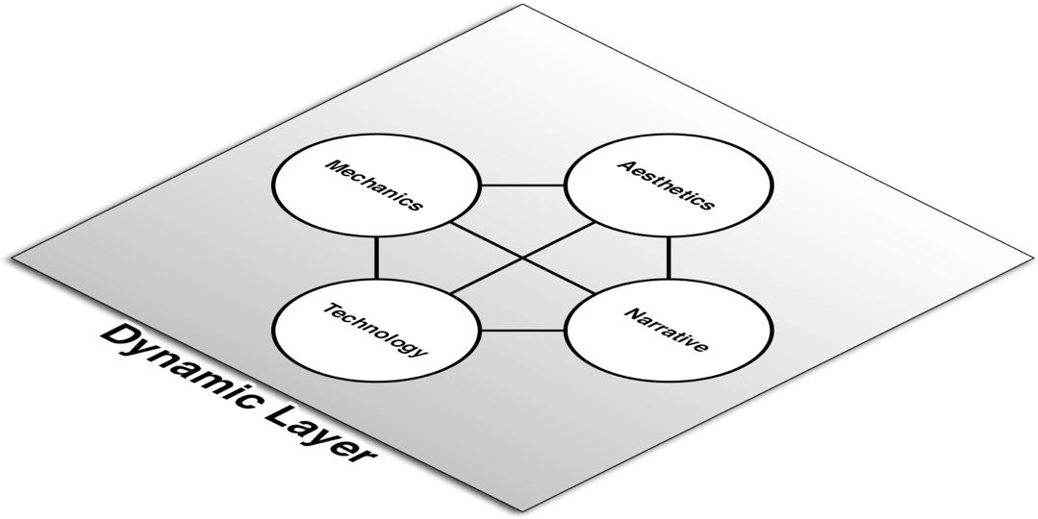

The Role of the Player
A game isn't a game unless someone is playing it.
Other forms of media can still exist without an audience.
But a game is fundamentally altered by the participation of the player.
Players move the game into the Dynamic Layer.
Players

Slide 2
The Dynamic Layer: Mechanics
House Rules
Players make small modifications to the inscribed rules.
Most often happen in board and paper games.
Can be intentional or unintentional.
If your inscribed rules are unclear, players may unintentionally create house rules.
Many player's first foray into game design!

Slide 3
The Dynamic Layer: Mechanics
Player Intent
The dynamic game experience is shaped by the intents of the players in the game.
John Bartle's four types of players who suit MUDs:
Achiever (Diamond)
Seeks to get the highest score in the game. Wants to dominate the game.
Explorer (Spade)
Seeks to find all the hidden places in the game. Wants to understand the game.
Socializer (Heart)
Wants to play the game with friends. Wants to understand the other players.
Killer (Club)
Wants to provoke other players of the game. Wants to dominate the other players.

Slide 4
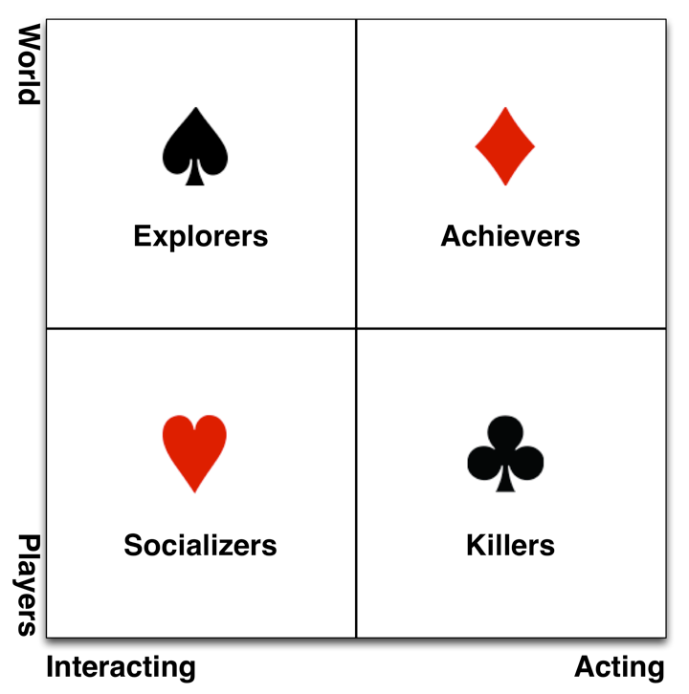
The Dynamic Layer: Mechanics
Bartle's types in a 2x2 continuum

Slide 5
The Dynamic Layer: Mechanics
Player Intent
The dynamic game experience is shaped by the intents of the players in the game.
John Bartle's four types of players who suit MUDs.
Achiever (Diamond)
Explorer (Spade)
Socializer (Heart)
Killer (Club)
Two types of players you don't want in your games:
Cheater
Wants to win. Doesn't care about integrity of the game.
Spoilsport
Doesn't care about winning. Wants to ruin game.

